Slide 1
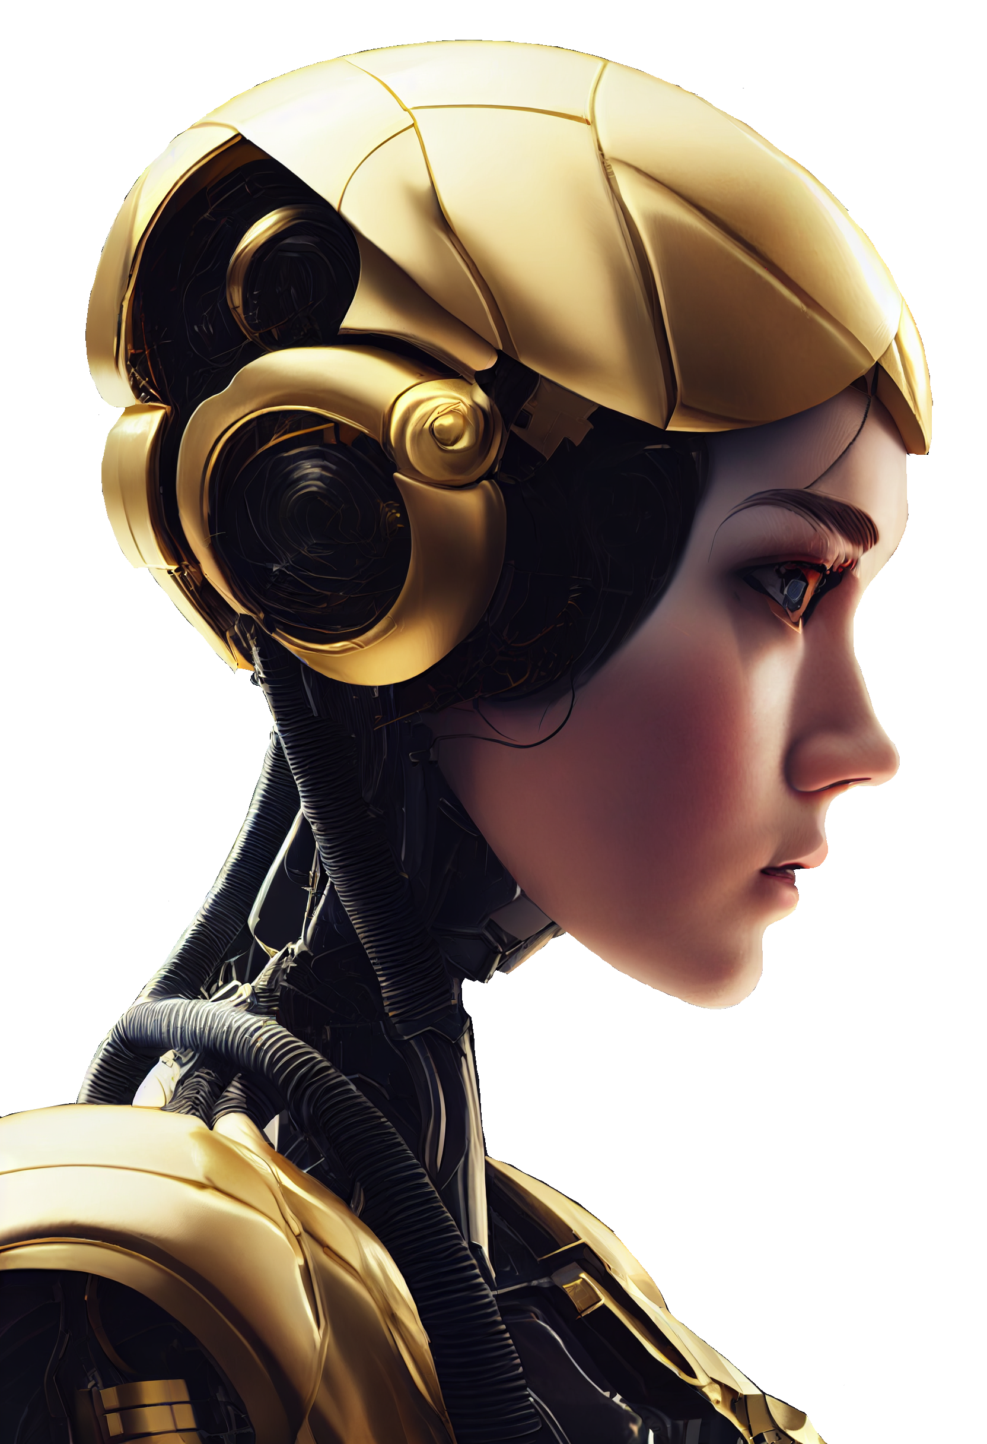
AI
ARTIFICIAL INTELLIGENCE
HISTORIE
1936, Turing machine
1956, AI
1972, AI enters medicine
1997, Computer beats world chess champion
2011, AI reaches everyday life

Slide 2

AI
ARTIFICIAL INTELLIGENCE
HISTORY
1936, Turing machine
1956, AI
1972, AI enters medicine
1997, Computer beats world chess champion
2011, AI reaches everyday life

Slide 3
AI / MACHINE LEARNING
Teaching
Feeding Data
HISTORY
AI
1936, Turing machine
1956, AI
1972, AI enters medicine
1997, Computer beats world chess champion
2011, AI reaches everyday life
ARTIFICIAL INTELLIGENCE

Slide 4
IMAGE AIs
Feeding image and text pairs
Being able to label images with text
Interpret human words into images
AI / MACHINE LEARNING
Teaching
Feeding Data
HISTORY
1936, Turing machine
1956, AI
1972, AI enters medicine
1997, Computer beats world chess champion
2011, AI reaches everyday life
Notes:
- teach a computer to perform a task without explicitly programming it to perform said task.
- instead feed data into an algorithm, to gradually improve outcomes, given prior experiences - just like organic life

Slide 5
IMAGE AIs
Feeding image and text pairs
Being able to label images with text
Interpret human words into images
AI / MACHINE LEARNING
Teaching
Feeding Data
Notes:
by teaching an algorithm, what certain things are, like saying "this image is a ball", it will eventually be able to label certain things in an image.
with this dataset, we can interpret human words into an entirely novel image. (drastic simplification of an Image AI)

Slide 6
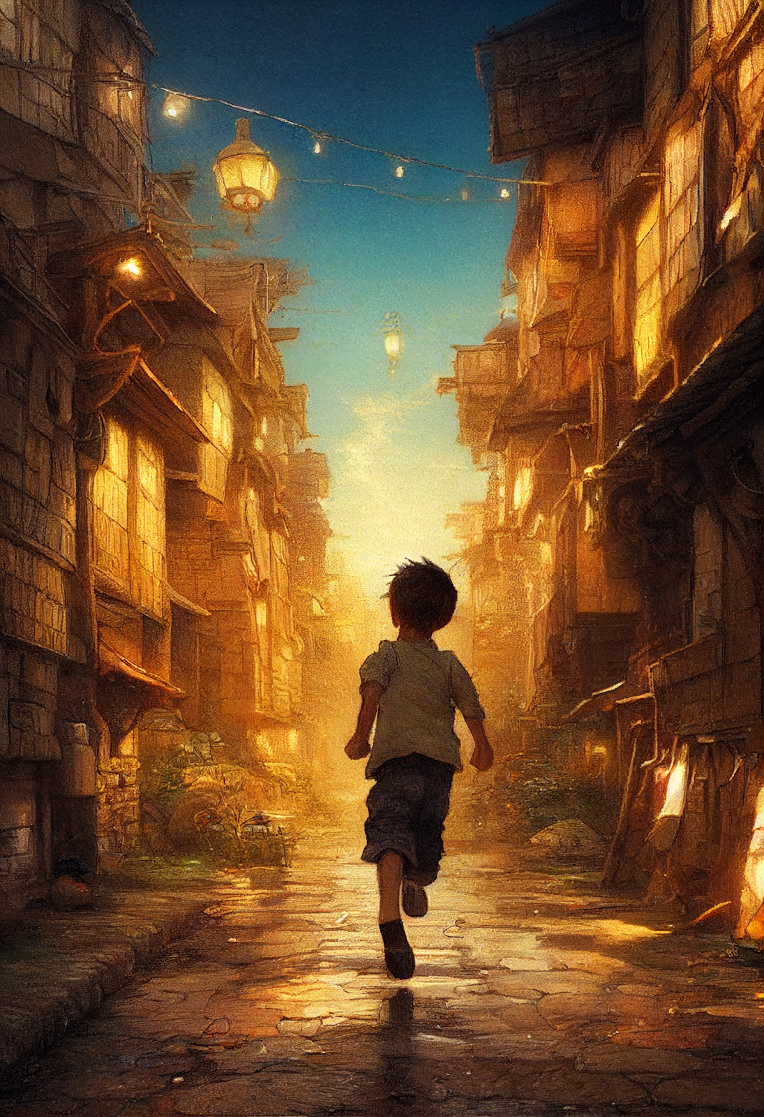
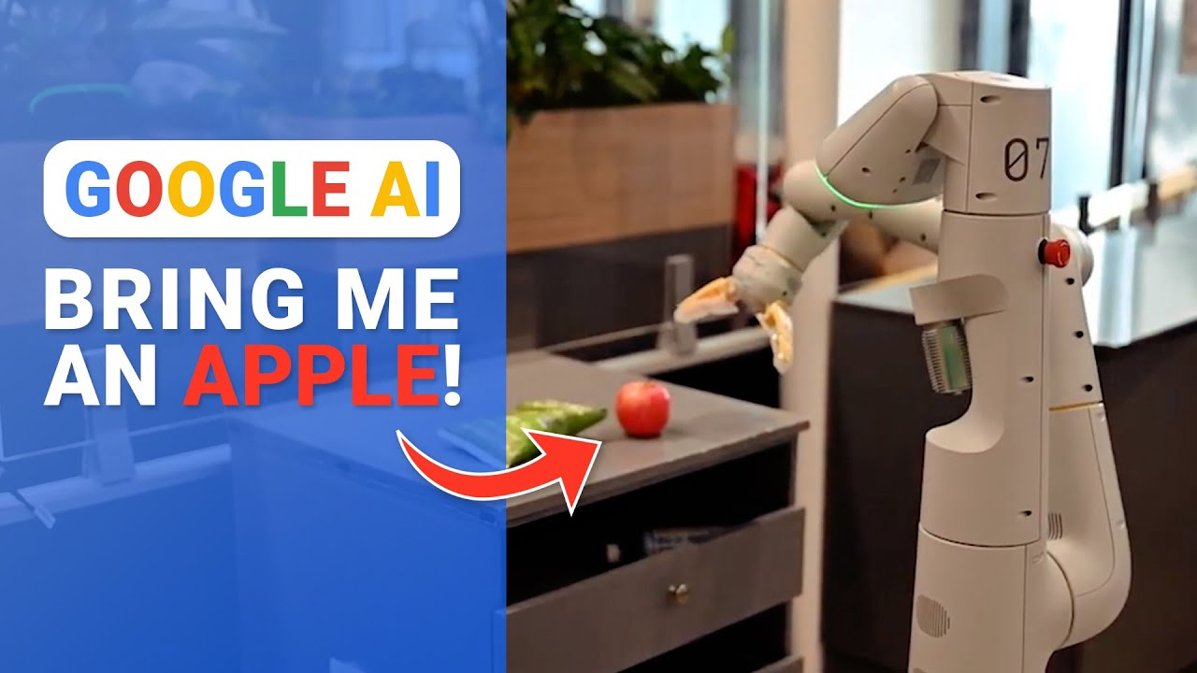
IMAGE AIs
PROMPT:
boy running through slums:
GOOGLE’s AIs
Text to Video AI
Robot Butler AI

Slide 7
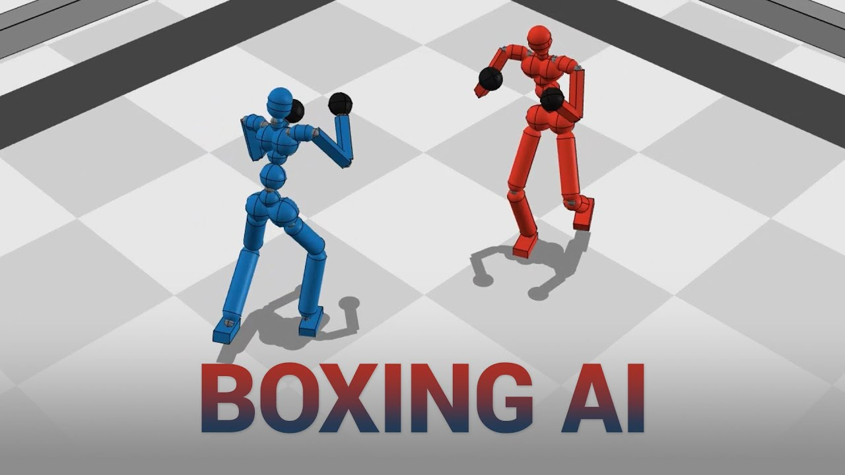
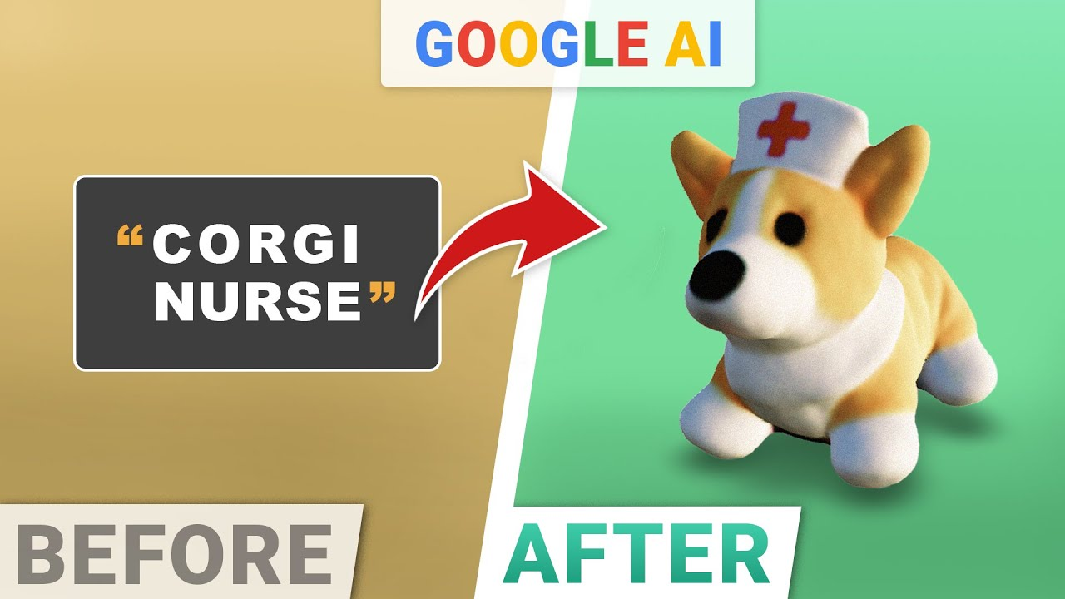
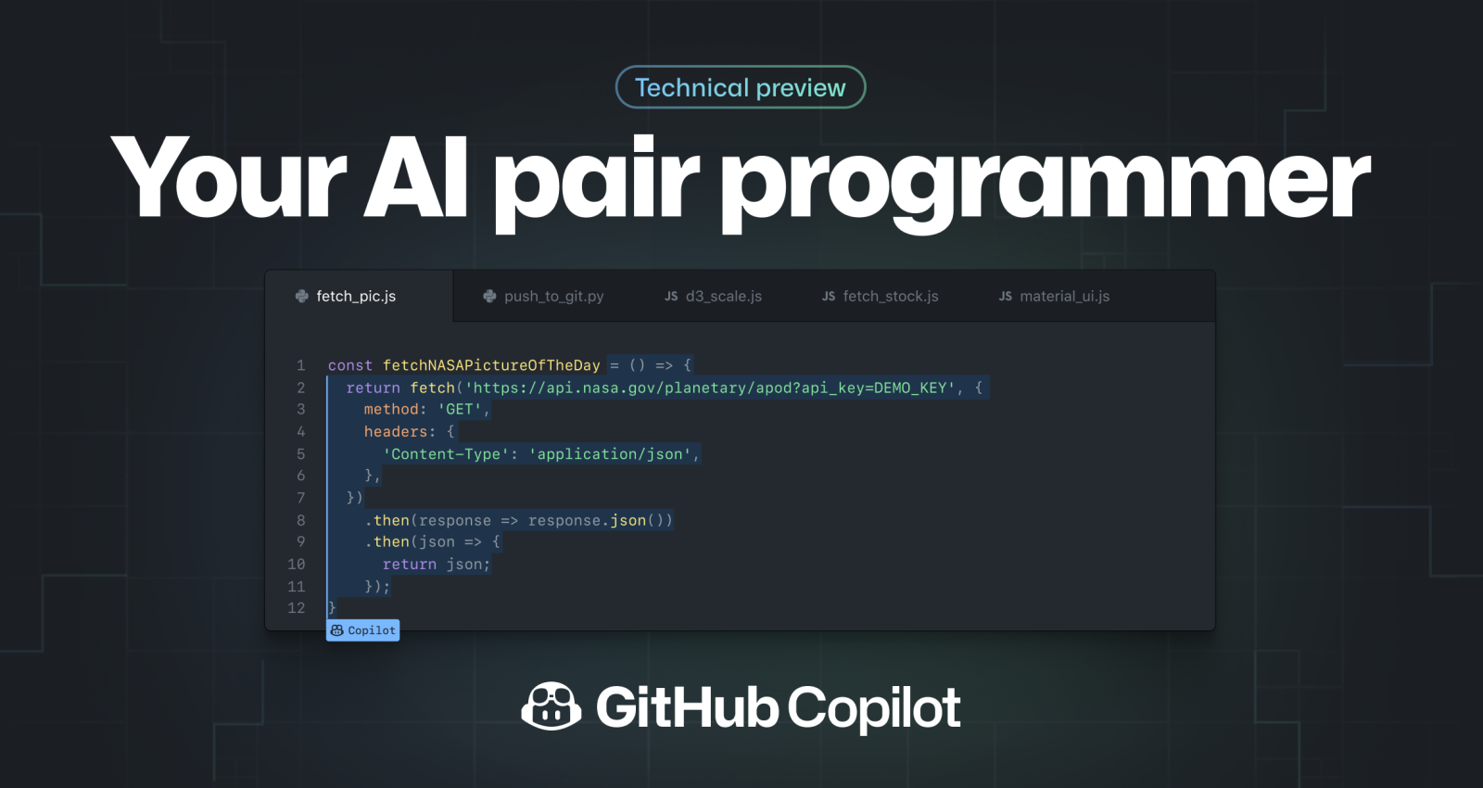
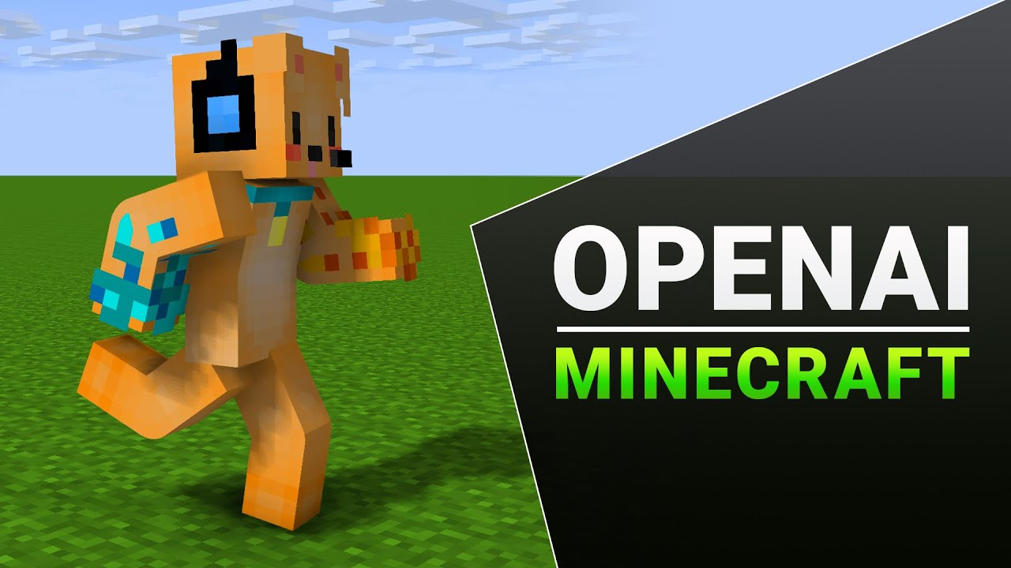
OTHER AIs
IMAGE AIs
PROMPT:
boy running through slums:
GOOGLE’s AIs
Text to Video AI
Robot Butler AI
Notes:
google's AI (parti AI)
can create a series of images, which just means video, given a single prompt.
Google also made a real life robot, which reacts on command of a human!
you can say: "bring me an apple", and the robot takes notice of its surrounding, avoiding obstacles and maybe even come up with alternative conclusions, like suggesting a banana, when the apple, for some reason, is unavailable.

Slide 8
PLACEGOLDER 1
OTHER AIs
QUESTION 1
GOOGLE’s AIs
Text to Video AI
Robot Butler AI

Slide 9
PLACEHOLDER 2
QUESTION 2
QUESTION 1
PLACEGOLDER 1
MOVEMENT AIS
Characters get a simple task
They learn from prior experiences…

Slide 10
PLACEHOLDER 3
QUESTION 3
QUESTION 2
PLACEHOLDER 2
QUESTION 1
PLACEGOLDER 1

Slide 11
PLACEHOLDER 4
QUESTION 4
QUESTION 3
PLACEHOLDER 3
QUESTION 2
PLACEHOLDER 2

Slide 12
THANKS FOR YOUR ATTENTION
QUESTIONS?
QUESTION 4
PLACEHOLDER 4
QUESTION 3
PLACEHOLDER 3

Slide 13
THANKS FOR YOUR ATTENTION
QUESTIONS?
QUESTION 4
PLACEHOLDER 4

